Slide 1

Phase Retrieval Applied to Asteroid Silhouette Characterization by Stellar Occultation
Russell Trahan & David Hyland
JPL Foundry Meeting – April 21, 2014

Slide 2
Outline
Introduction ○○○○○○○ Estimation ○○○○○○○○○○○ Noise ○○○○○ Coverage ○○○○○○ Conclusion ○○
Introduction
  Occultation to detect asteroids
  Characteristics of a shadow
  Shadows of distant, small bodies
  Motivation for asteroid detection
Silhouette Estimation
  Derivation of shadow pattern
  Silhouette recovery from the shadow pattern
  Raster scan method
  Example
Measurement Noise
  Noise model
  Effect on raster scan estimation method
Data Coverage
  Sparse measurement of the shadow pattern
  Measurement position uncertainty
  Measurements to silhouette resolution ratio
Conclusion

Slide 3

Traditional Occultation Method to Characterize Asteroids
Introduction ●○○○○○○ Estimation ○○○○○○○○○○○ Noise ○○○○○ Coverage ○○○○○○ Conclusion ○○
Array of Light Collectors
Velocity Relative to Shadow
Occluding Asteroid
Distant Star
Shadow Region
Each moving observer records the time when the star disappears and reappears. The shape of the shadow region can be estimated based on the occultation times and the positions of the observers.
Data Collection and
Time Keeping

Slide 4
Characteristics of a Shadow
Introduction ●●○○○○○ Estimation ○○○○○○○○○○○ Noise ○○○○○ Coverage ○○○○○○ Conclusion ○○
Distant star illuminates asteroid and casts shadow
Fresnel Number:
Observer is far enough away that no shadow is visible
Diffraction effects dominate
Coordinate systems normalized by distance to the asteroid
Observation Location
Interference Zone
Shadow Zone
Shadow
Fresnel Region
Fraunhofer Region

Slide 5
Shadows of Small, Distant Bodies
Introduction ●●●○○○○ Estimation ○○○○○○○○○○○ Noise ○○○○○ Coverage ○○○○○○ Conclusion ○○
Huygens-Fresnel principle applied to shadows gives the wave field at the observer’s spatial location .
The silhouette function is defined as
Silhouette
Shadow Pattern

Slide 6
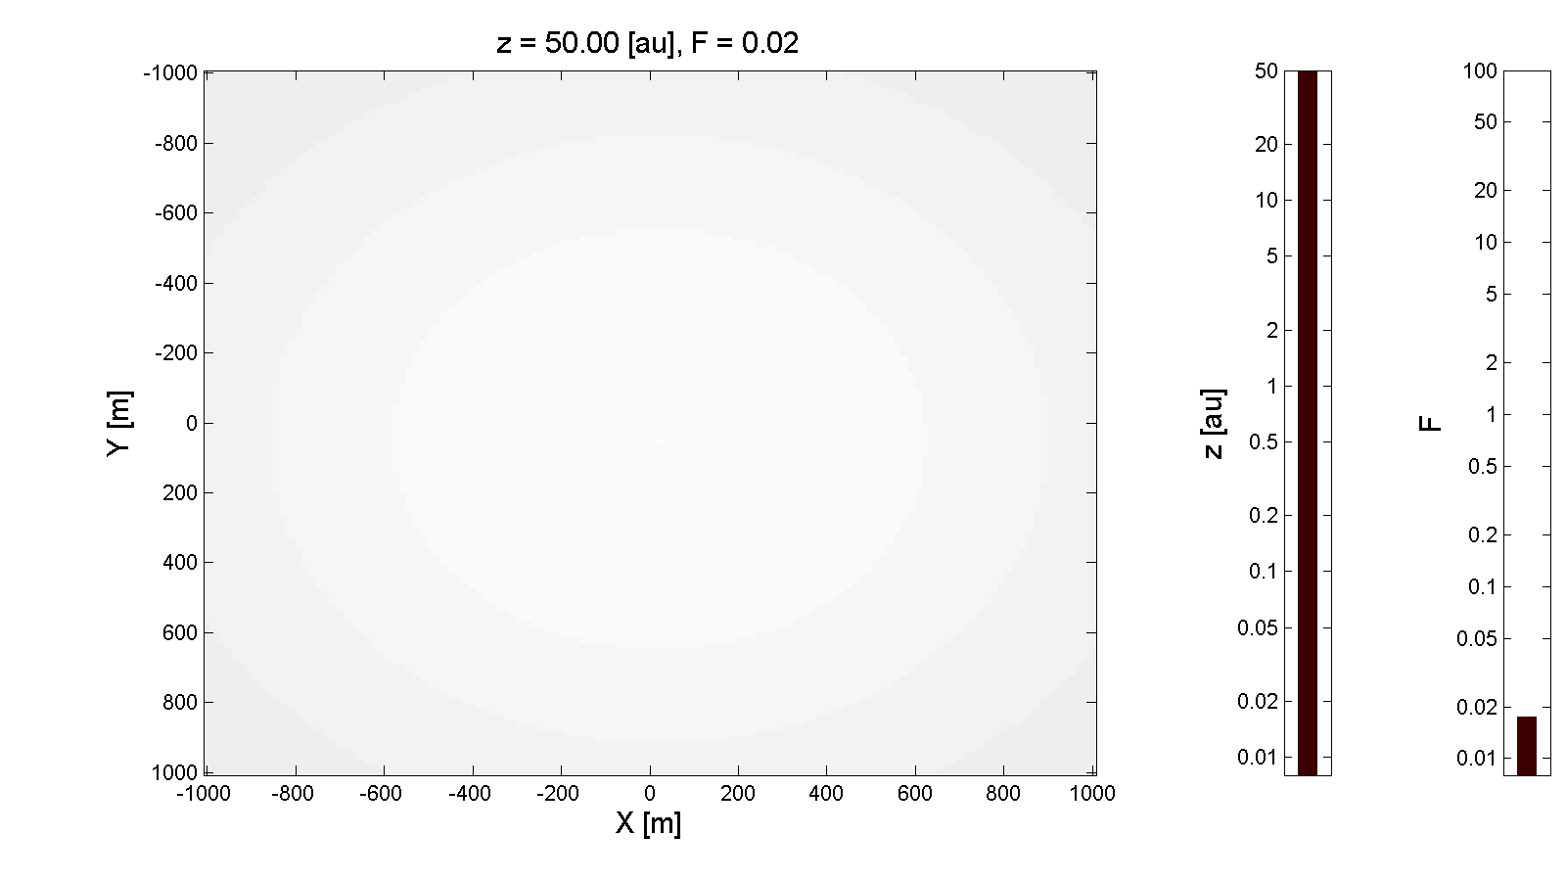
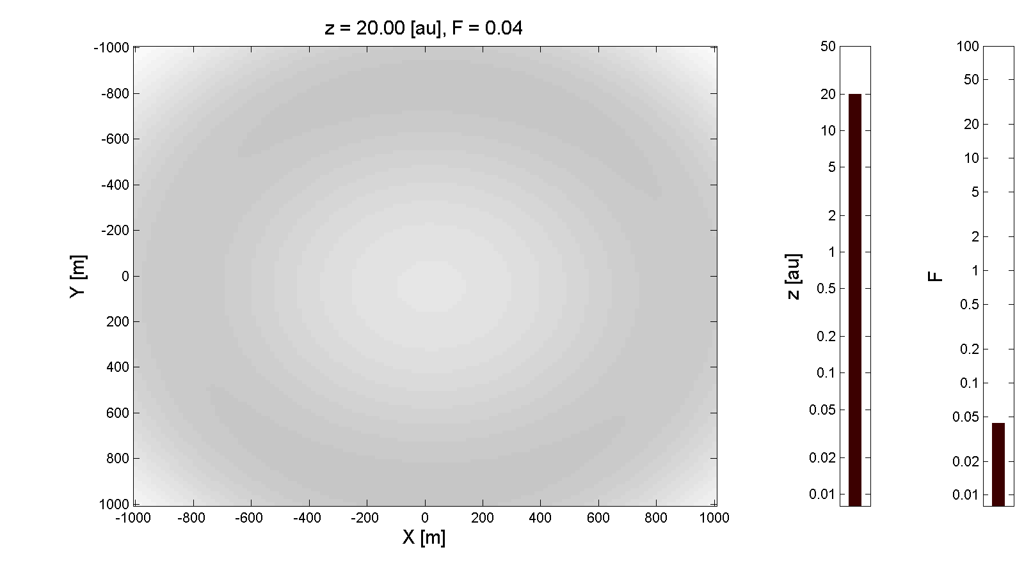
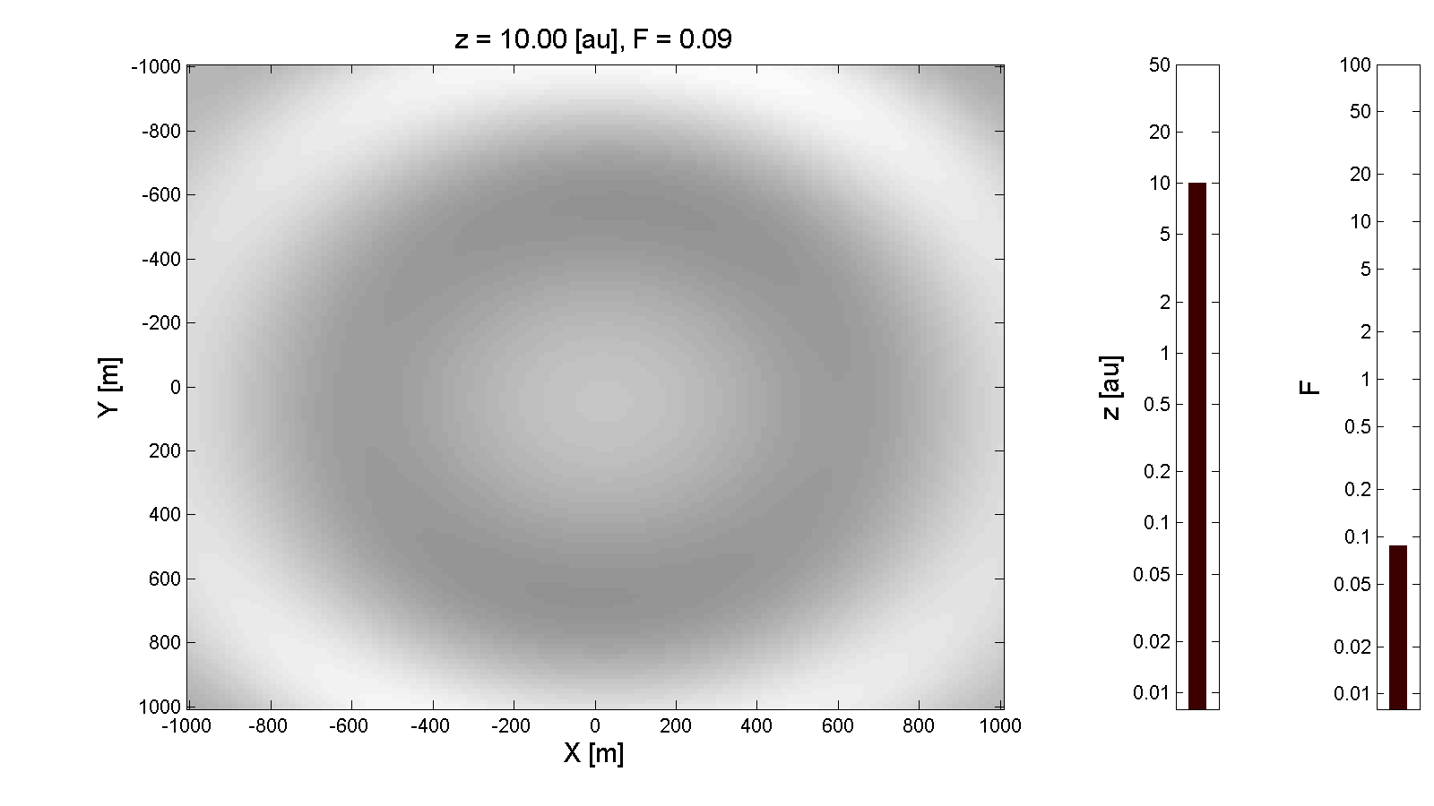
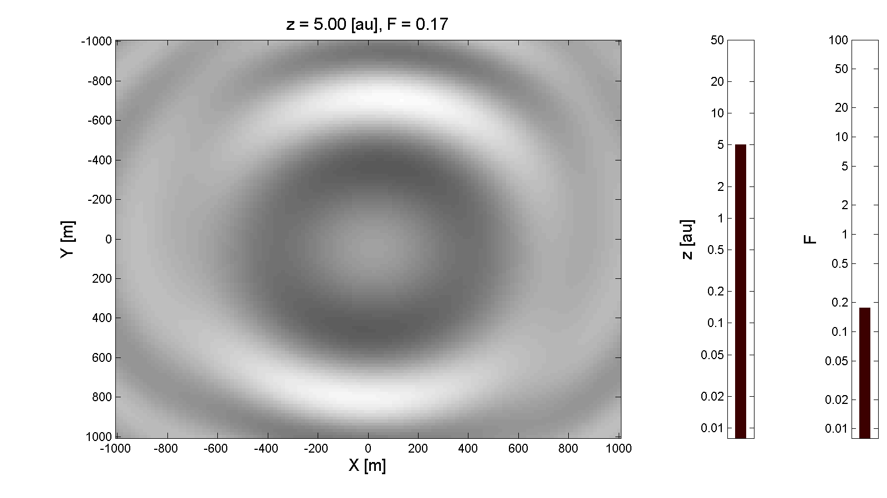
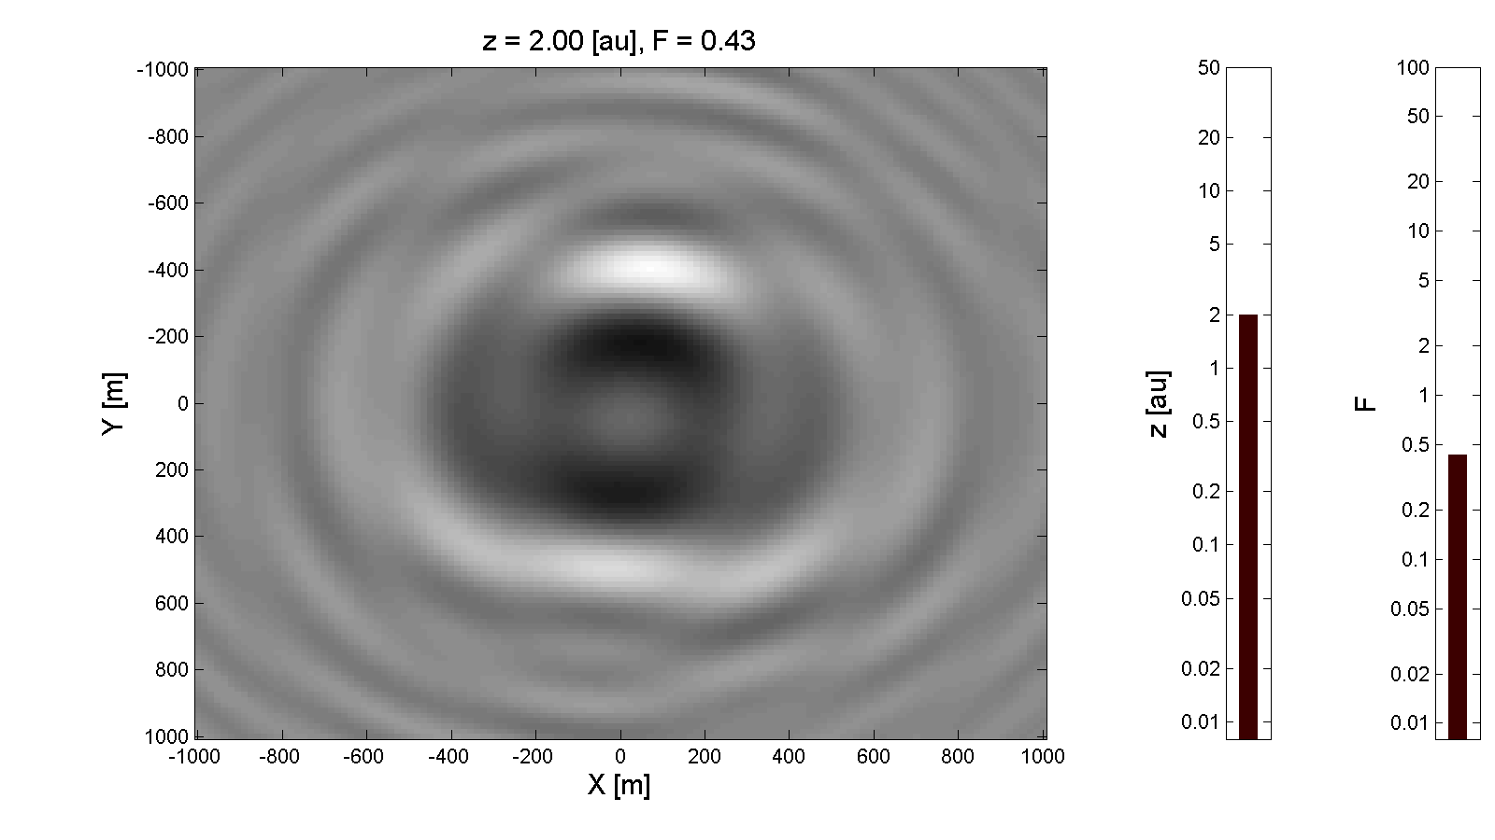
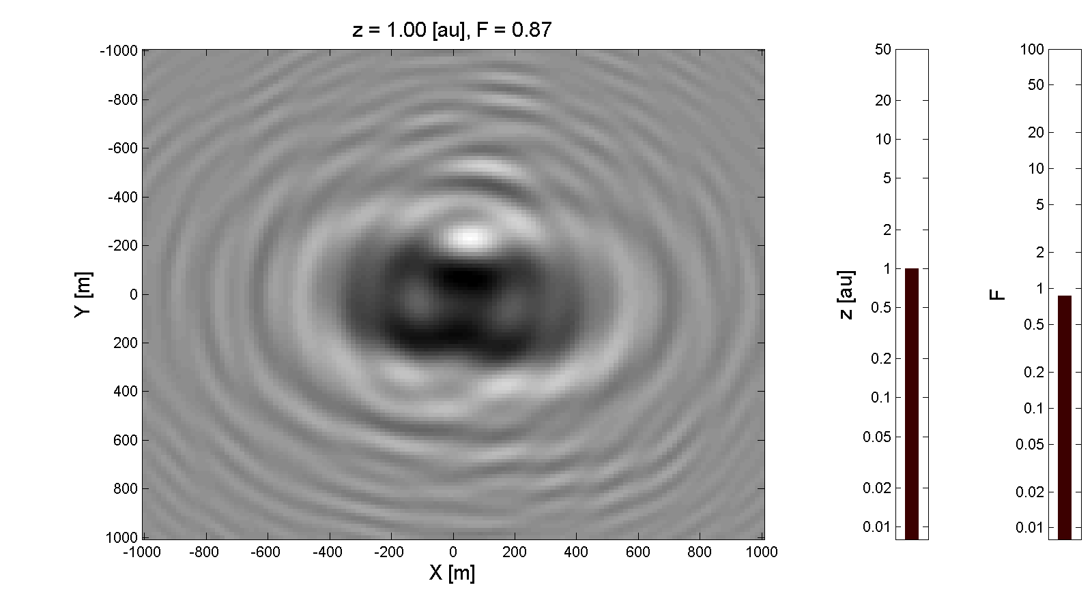
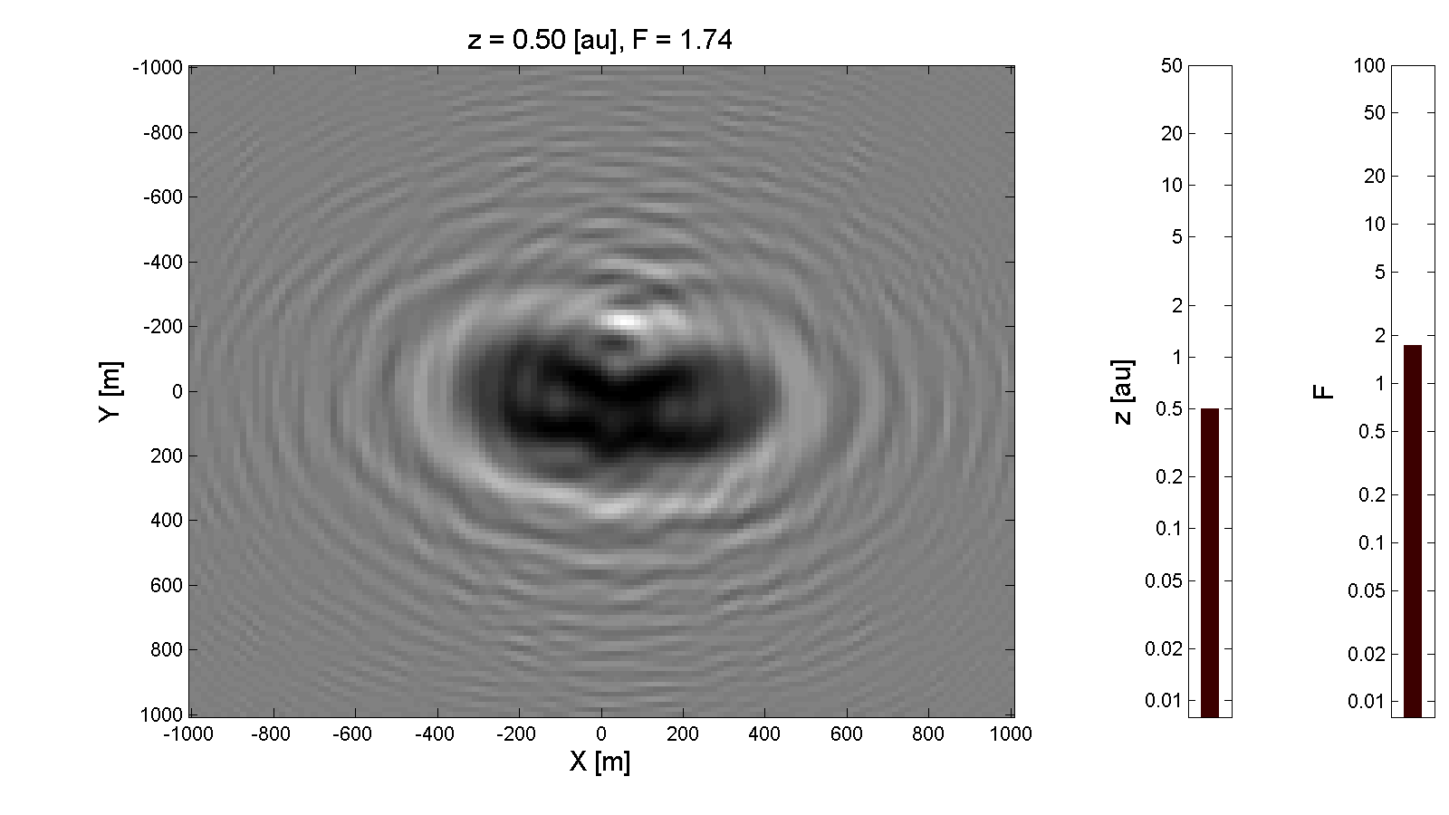
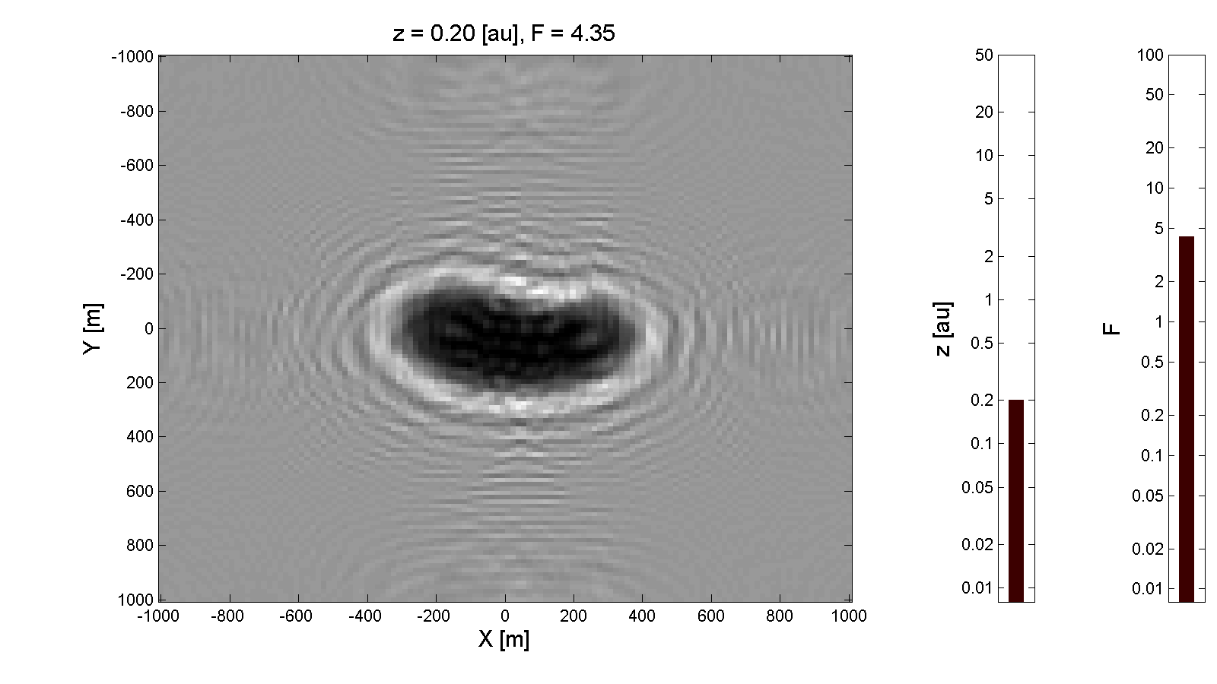
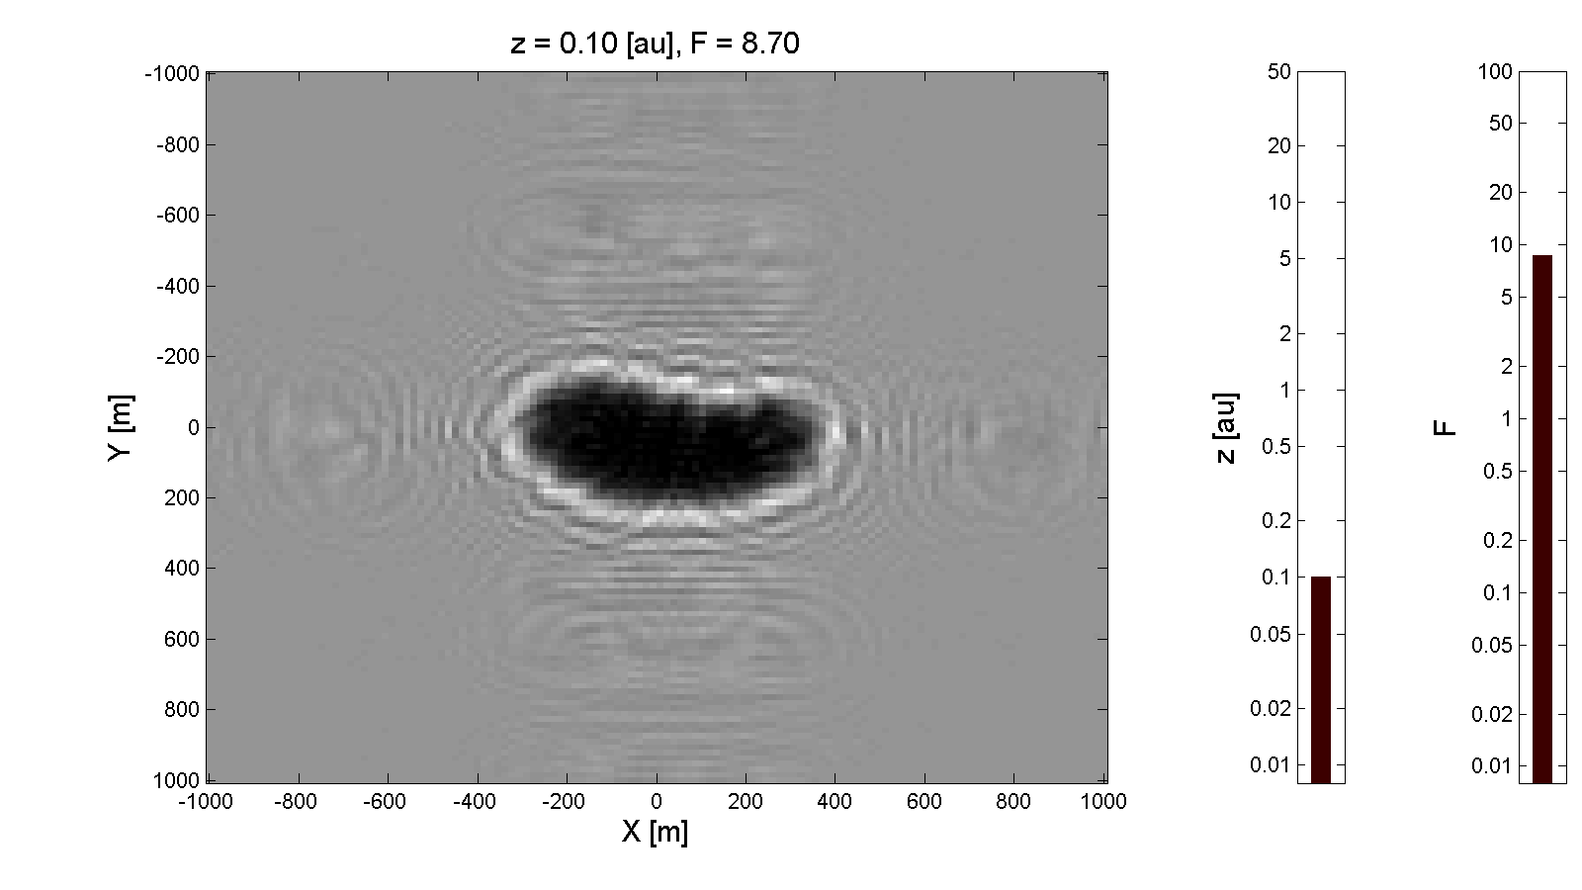
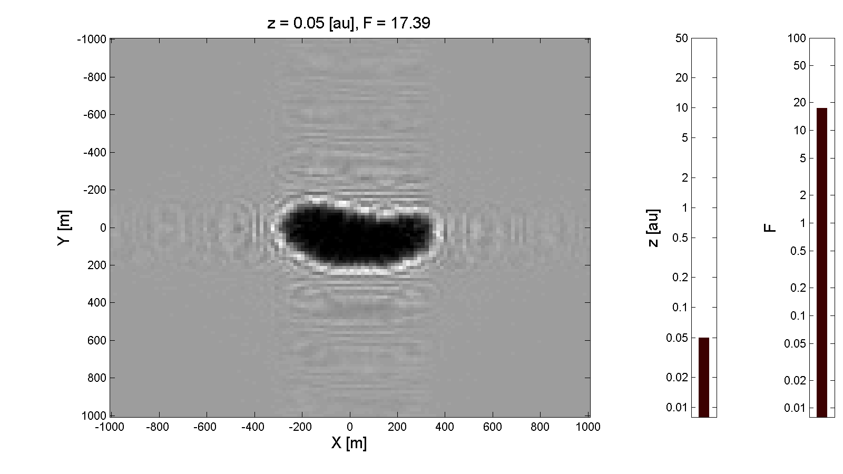
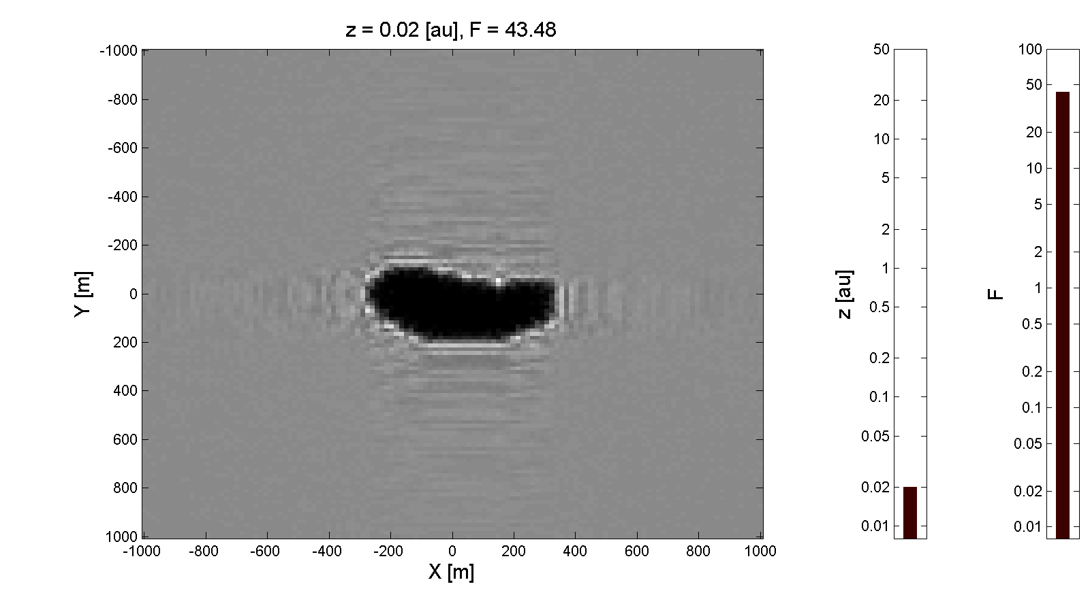
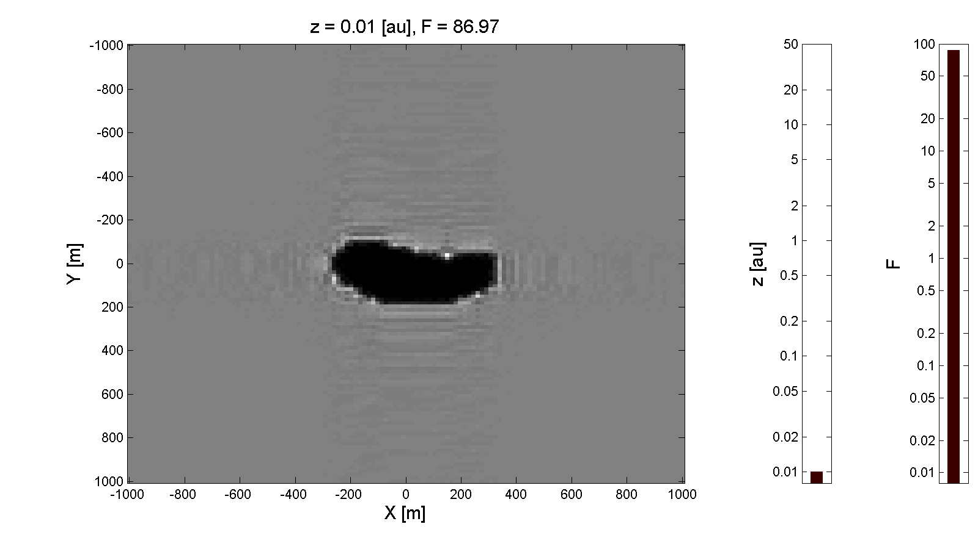
Shadow Pattern vs.
Fresnel Number
Introduction ●●●●○○○ Estimation ○○○○○○○○○○○ Noise ○○○○○ Coverage ○○○○○○ Conclusion ○○

Slide 7
Asteroids of Interest
Introduction ●●●●●○○ Estimation ○○○○○○○○○○○ Noise ○○○○○ Coverage ○○○○○○ Conclusion ○○
Diameter (m) | >1000 | 1000-140 | 140-40 | 40-1
# Estimated | 966 | 14,000 | ~285,000 | --
# Observed | 899 | 4,557 | 2,259 | 1,685
% Observed | 93% | ~33% | ~1% | --
Distance (km) for F=50 | >10,000,000 | <10,000,000 >200,000 | <200,000 >15,000 | <15,000 >10
Distance (au) for F=50 | >0.07 | <0.07 >0.001 | <0.001 >0.0001 | <0.0001 >7e-8
Distance (km) for F=0.5 | >1,000,000,000 | <1,000,000,000 >20,000,000 | <20,000,000 >1,500,000 | <1,500,000 >1,000
Distance (au) for F=0.5 | >7 | <7 >0.1 | <0.1 >0.01 | <0.01 >7e-6
For a sharp shadow to exist for 140-40m diameter asteroids, it must pass within 98,000 km.
140-40m is large enough to cause significant damage upon impact
Only ~1% are accounted for

Slide 8
Field of View for 100m Asteroid Using Traditional Occultation
Introduction ●●●●●●○ Estimation ○○○○○○○○○○○ Noise ○○○○○ Coverage ○○○○○○ Conclusion ○○
Figure drawn to scale

Slide 9
Field of View for 100m Asteroid Using Shadow Pattern
Introduction ●●●●●●● Estimation ○○○○○○○○○○○ Noise ○○○○○ Coverage ○○○○○○ Conclusion ○○
Figure drawn to scale

Slide 10
Discrete Fourier Transformation of Shadow Pattern?
Introduction ●●●●●●● Estimation ●○○○○○○○○○○ Noise ○○○○○ Coverage ○○○○○○ Conclusion ○○
Intensity of wave field, , is known
Wave field equation looks like Fourier transform of complex function
Discretizations need to be small enough to capture high frequencies.
For and (green light),
Integration limits over are not captured in the discrete Fourier transform
Would require complete knowledge of

Slide 11
Discrete Fourier Transformation of Shadow Pattern? (2)
Introduction ●●●●●●● Estimation ●●○○○○○○○○○ Noise ○○○○○ Coverage ○○○○○○ Conclusion ○○
True Shadow Pattern
Shadow Pattern from DFT
Wrong! Physics lost in DFT

Slide 12
Recovery of the
Silhouette Function
Introduction ●●●●●●● Estimation ●●●○○○○○○○○ Noise ○○○○○ Coverage ○○○○○○ Conclusion ○○
Huygens-Fresnel principle applied to shadows gives the wave field at the observer location .
The silhouette function is defined as
The measured intensity of the wave field is

Slide 13
Recovery of the
Silhouette Function (2)
Introduction ●●●●●●● Estimation ●●●●○○○○○○○ Noise ○○○○○ Coverage ○○○○○○ Conclusion ○○
Integral over the silhouette can be split into a grid and evaluated
Silhouette

Slide 14
Recovery of the
Silhouette Function (3)
Introduction ●●●●●●● Estimation ●●●●●○○○○○○ Noise ○○○○○ Coverage ○○○○○○ Conclusion ○○
is the estimated silhouette’s shadow pattern.
is the measured shadow pattern.
When the correct silhouette is found, the two shadow patterns should match.
An error metric can be defined as
Objective is to change the estimated silhouette until the error is minimized.

Slide 15
Problem Flowchart
Introduction ●●●●●●● Estimation ●●●●●●○○○○○ Noise ○○○○○ Coverage ○○○○○○ Conclusion ○○
True Silhouette
Estimated Silhouette
Minimize Difference
Measured Shadow Pattern
Estimated Shadow Pattern

Slide 16
Raster Scan Algorithm
Introduction ●●●●●●● Estimation ●●●●●●●○○○○ Noise ○○○○○ Coverage ○○○○○○ Conclusion ○○
Startup
  Compute the contribution of each element of the summation and store in memory
  Make initial guess
Iteration over each pixel in the image
  Flip the element of
  Construct the new using the contributions previously computed for each pixel
  Compare the measured and estimated shadow patterns
  Keep the change if the error decreased

Slide 17
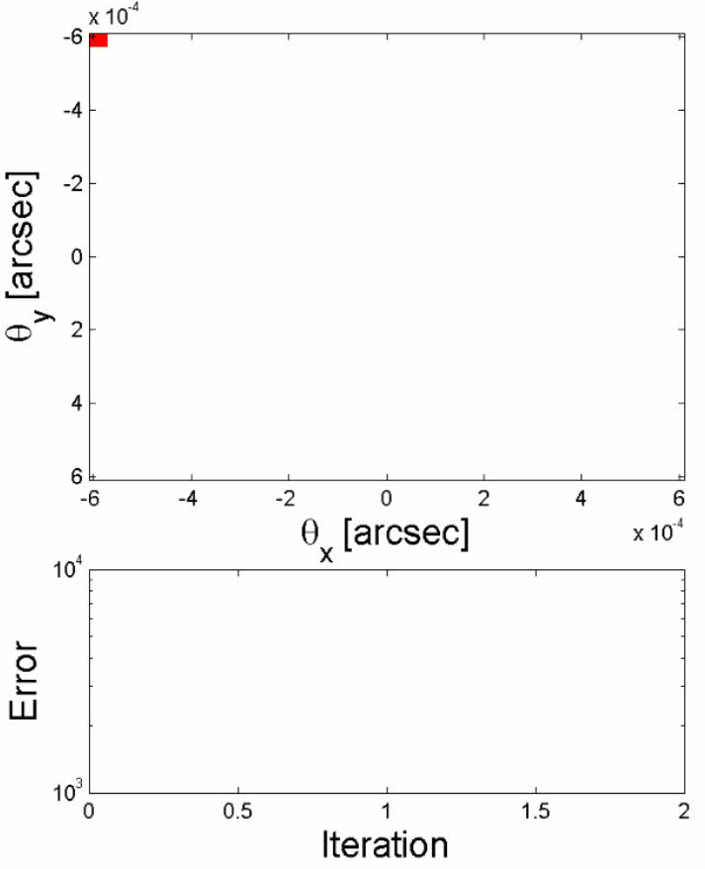
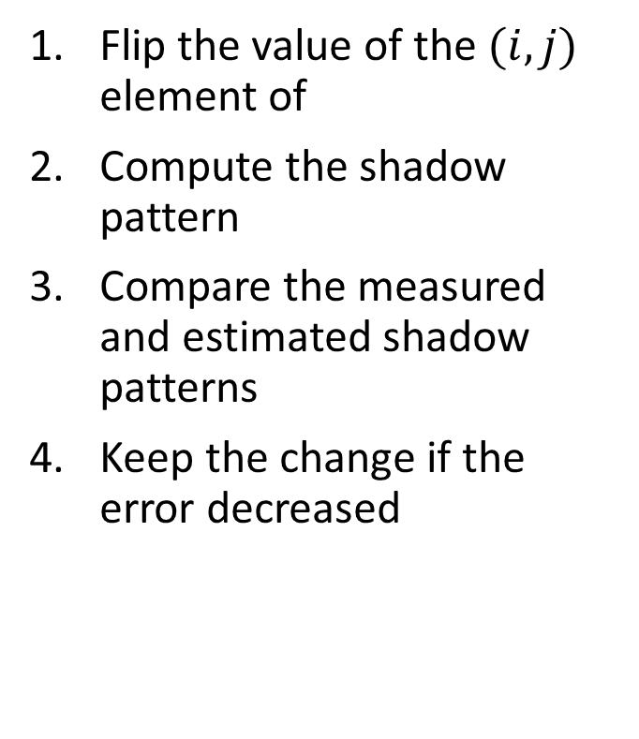
Raster Scan Example
Introduction ●●●●●●● Estimation ●●●●●●●●○○○ Noise ○○○○○ Coverage ○○○○○○ Conclusion ○○
Flip the value of the $(i,j)$ element of
Compute the shadow pattern
Compare the measured and estimated shadow patterns
Keep the change if the error decreased

Slide 18
Successive Nested Grids
Introduction ●●●●●●● Estimation ●●●●●●●●●○○ Noise ○○○○○ Coverage ○○○○○○ Conclusion ○○
32x32 Pixels
128x128 Pixels
64x64 Pixels

Slide 19
Raster Scan Performance
Introduction ●●●●●●● Estimation ●●●●●●●●●●○ Noise ○○○○○ Coverage ○○○○○○ Conclusion ○○
Susceptible to stagnation
  If no change has occurred for an entire iteration, the solution has converged or stagnated.
  Since only one pixel is changed at a time, local minima are prevalent.
  Randomly change a few pixel values to move away from the local minimum.
No specific method of filtering noise has been developed yet.
User chooses the resolution of the estimated silhouette
Low resolution estimate can be the initial guess for a high resolution estimate
Only a comparison is made between the measured and estimated shadow pattern
  Complete data coverage is not necessary!
  How much coverage is necessary is still unknown.
This simple ‘first guess’ approach seems to work fairly well.

Slide 20
Raster Scan Computational Performance
Introduction ●●●●●●● Estimation ●●●●●●●●●●● Noise ○○○○○ Coverage ○○○○○○ Conclusion ○○
Computation is performed offline. Relaxed computational requirements.
Construction of the shadow pattern can be parallelized for each pixel in the UV plane.
Comparison of the shadow patterns can be mostly parallelized for each pixel in the UV plane.
Current Matlab implementation is quite slow, ~6 minutes per iteration for 64x64 pixels. GPU implementation could promise unnoticeable runtimes.
These insights imply computational expense should not be a factor in the algorithm development.

Slide 21
Noise Model
Introduction ●●●●●●● Estimation ●●●●●●●●●●● Noise ●○○○○ Coverage ○○○○○○ Conclusion ○○
The measured intensity contains several sources of noise:
  Light sensor noise
  Aperture direction
  Aperture position
  Estimated range-to-target, z
  Rotation of the target
The complex wave field’s real and imaginary components are corrupted.
Noise model:

Slide 22
Raster Scan Performance with Noise
Introduction ●●●●●●● Estimation ●●●●●●●●●●● Noise ●●○○○ Coverage ○○○○○○ Conclusion ○○
25 Monte Carlo trials at several noise levels
Track error between the true and estimated shadow patterns
Erratic behavior near zero noise – not fully explained yet
Linear growth in error after 10% noise level
Mean Error
Final Error to
Max Error Ratio
Iteration
Noise StDev
Noise StDev

Slide 23
Result with 0.25 Noise StDev
Introduction ●●●●●●● Estimation ●●●●●●●●●●● Noise ●●●○○ Coverage ○○○○○○ Conclusion ○○
True Error
Iteration
Reference Error
Iteration

Slide 24
“Executive Eye” Manipulation
Introduction ●●●●●●● Estimation ●●●●●●●●●●● Noise ●●●●○ Coverage ○○○○○○ Conclusion ○○
Changed Pixels
Estimate after 5 Additional Iterations
True Silhouette

Slide 25
Result with 0.5 Noise StDev
Introduction ●●●●●●● Estimation ●●●●●●●●●●● Noise ●●●●● Coverage ○○○○○○ Conclusion ○○
Noisy Measurement of the
Shadow Pattern
Estimate after
5 Iterations

Slide 26
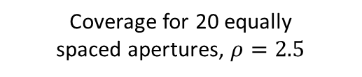
Typical Data Coverage Pattern
Introduction ●●●●●●● Estimation ●●●●●●●●●●● Noise ●●●●● Coverage ●○○○○○ Conclusion ○○
Relative velocity of shadow pattern dominant in constellation
Linear coverage path across the UV plane
Pattern may not be regular
Ratio of # measurements to image
pixels,
Coverage for 20 equally
spaced apertures, $ρ=2.5$
Perfect Recovery
Reference Error
Denotes no data
Iteration

Slide 27

10 Aperture Coverage, $ρ=1.25$
Introduction ●●●●●●● Estimation ●●●●●●●●●●● Noise ●●●●● Coverage ●●○○○○ Conclusion ○○
Reference Error
Iteration

Slide 28

8 Aperture Coverage, $ρ=1$
Introduction ●●●●●●● Estimation ●●●●●●●●●●● Noise ●●●●● Coverage ●●●○○○ Conclusion ○○
Reference Error
Iteration

Slide 29
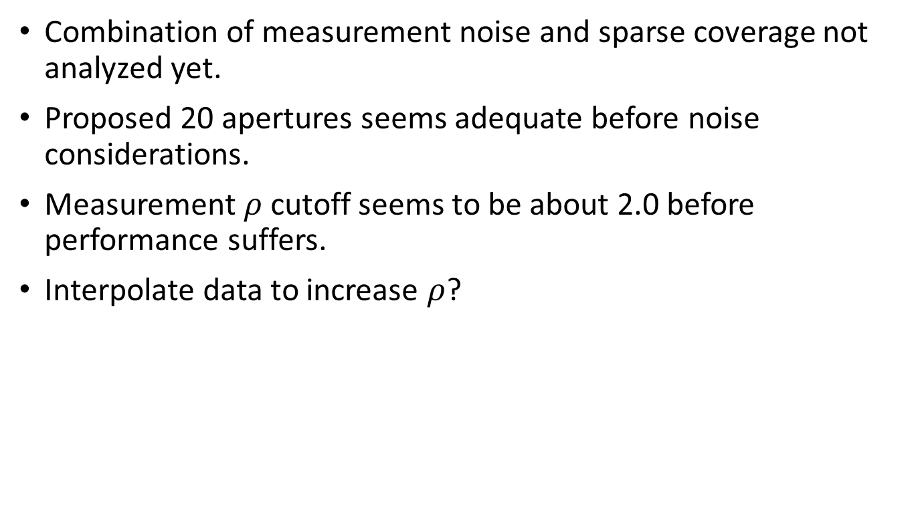
Data Coverage
Introduction ●●●●●●● Estimation ●●●●●●●●●●● Noise ●●●●● Coverage ●●●●○○ Conclusion ○○
Combination of measurement noise and sparse coverage not analyzed yet.
Proposed 20 apertures seems adequate before noise considerations.
Measurement $ρ$cutoff seems to be about 2.0 before performance suffers.
Interpolate data to increase $ρ$?

Slide 30

Aperture Position Error
Introduction ●●●●●●● Estimation ●●●●●●●●●●● Noise ●●●●● Coverage ●●●●●○ Conclusion ○○
True Positions, $σ=5m$
Erroneously Assumed Positions

Slide 31

Aperture Position Error
Introduction ●●●●●●● Estimation ●●●●●●●●●●● Noise ●●●●● Coverage ●●●●●● Conclusion ○○
True Positions, $σ=25m$
Erroneously Assumed Positions

Slide 32
Ongoing Work
Introduction ●●●●●●● Estimation ●●●●●●●●●●● Noise ●●●●● Coverage ●●●●●● Conclusion ●○
Finite star – wish to not consider the star to be a point source.
Finite bandwidth – wish to not assume an infinitesimal bandwidth of light.
What is a better raster scan method?
How far can we get with the nested grid idea?
How much data coverage of the shadow pattern is needed?
What can we do about noise?

Slide 33
Conclusions
Introduction ●●●●●●● Estimation ●●●●●●●●●●● Noise ●●●●● Coverage ●●●●●● Conclusion ●●
The traditional method of recording the disappearance and reappearance of the occluded star is not adequate for small asteroids.
Small asteroids ~100m can be characterized using shadow pattern data collected during a stellar occultation.
The shadow pattern cannot be directly inverted to obtain the silhouette. An estimation process is required.
The raster scan method gives good results for realistic test cases. Perhaps an even better performing method won’t be too complex.
We have some tools to answer the SNR and data coverage questions.

