Slide 1
PhysicAll Simulation Suite
Goals:
Goal provide powerful environment for developing any type of physics simulation
Provide built in functionality that most users would include in a simulation while maintaining complete control by the user
Seamlessly visualize the simulation environment at runtime
Balance the use of a graphical interface with raw code based on the users desired complexity
Simulate 100,000 degrees of freedom accurately in real-time

Slide 2
Key Features
Use of DirectCompute API (part of DirectX) for performing physics calculations on the GPU provides massive parallelization
Use of DirectCompute allows for the simulation and graphics display to be one and the same
State of the art graphics using DirectX11
Most of the PhysicAll Suite is the adaptation of video game technology to engineering simulation. Video game developers are learning to get the most computational power out of modern PCs. Engineers should capitalize on this.

Slide 3
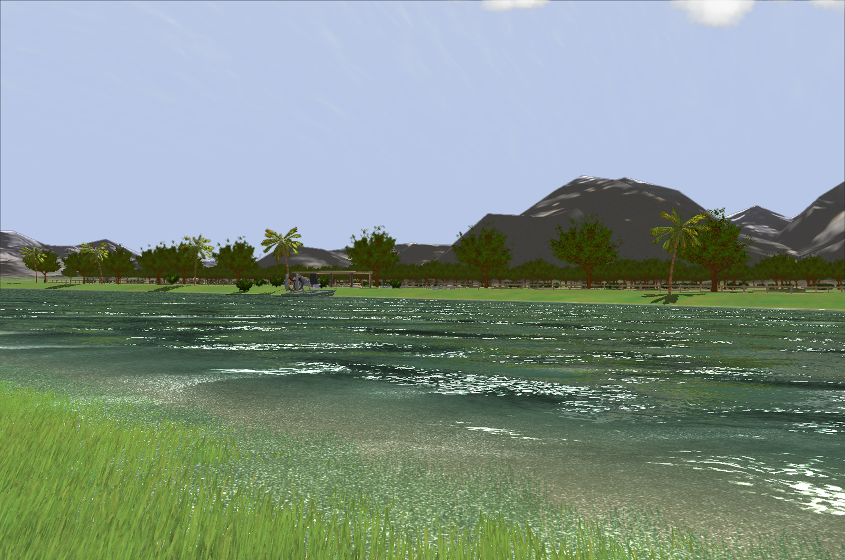
Graphics Abilities
The graphics abilities rival the latest video games on the market.
A fully interactive graphics interface provides tools to easily create graphics models in minutes.
A built in Direct3D shader editor, manager, and compiler gives the option to build complex animations and effects.
Easily capture screen-shots and record videos.

Slide 4
Simulation Features
Define physical properties and graphics representation of objects
Use built in options for inter-object gravity and collision detection
Various high-accuracy numerical integration schemes available
Utilize double-precision computations on supported GPU hardware
Write user-defined code to define forces on objects
Create/destroy object programmatically
Record object properties and states through time and generate plots and export data.

Slide 5
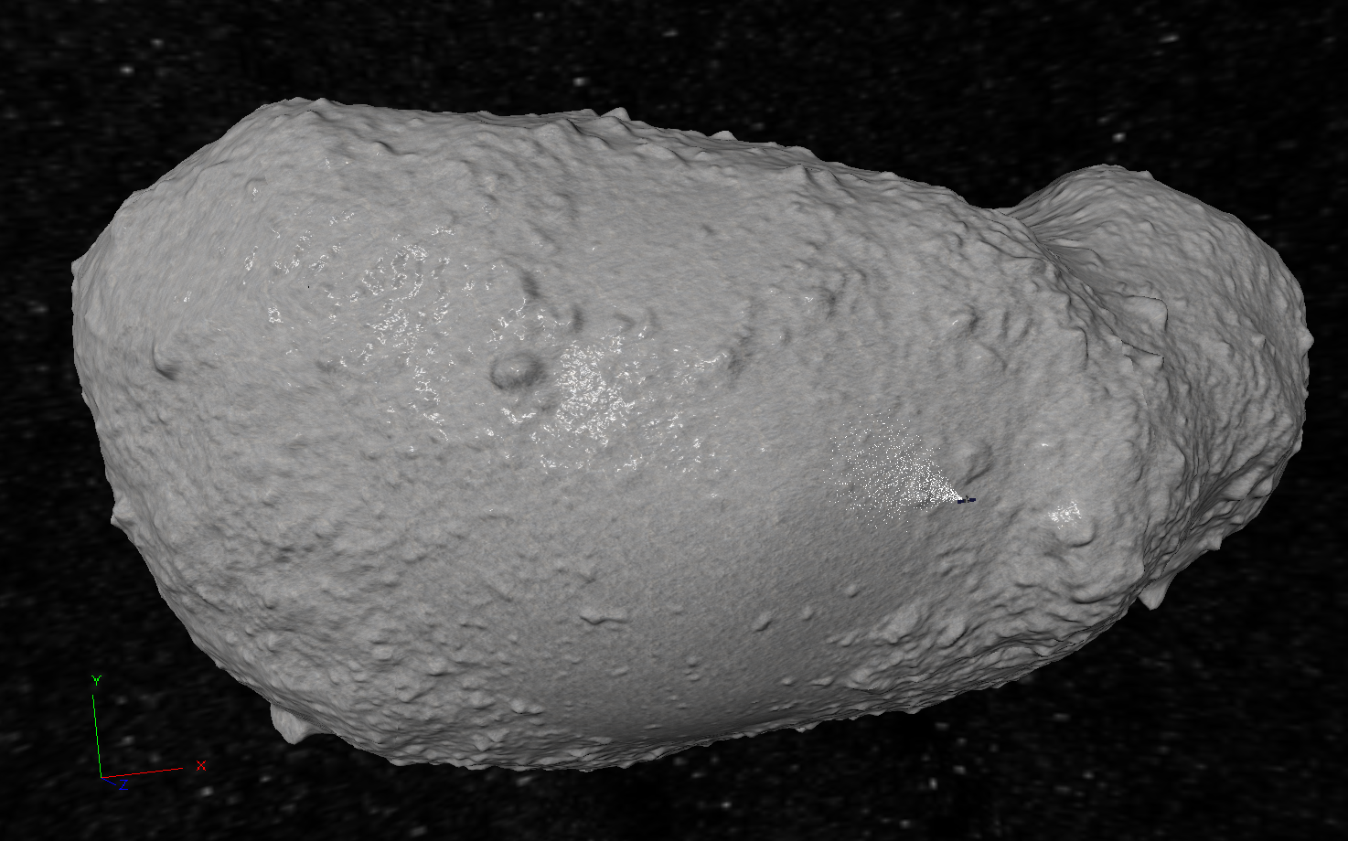
Sample Simulation
Spraying Paint on an Asteroid
Based on contracted work for the Experimental Center for Applied Physical Systems (ECAPS, LLC)
Simulation of tribo-charged particles being sprayed onto the asteroid Itokawa
Asteroid model uses high-fidelity data from the Hayabusa mission
Paint particles collide and stick to the complex asteroid geometry
Simulates 10s thousands degrees-of-freedom in near real-time.
Every particle interacts with every other particle via gravitation and electro-static attraction, N² interactions

Slide 6


Slide 7
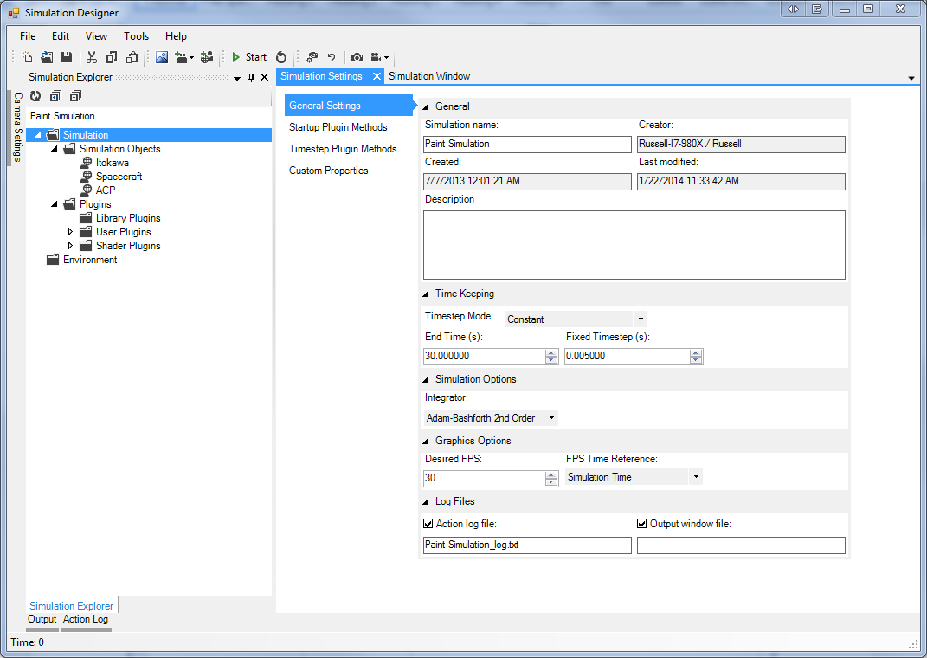
Screen Shot
Home Screen
Displays general simulation options and parameters.

Slide 8
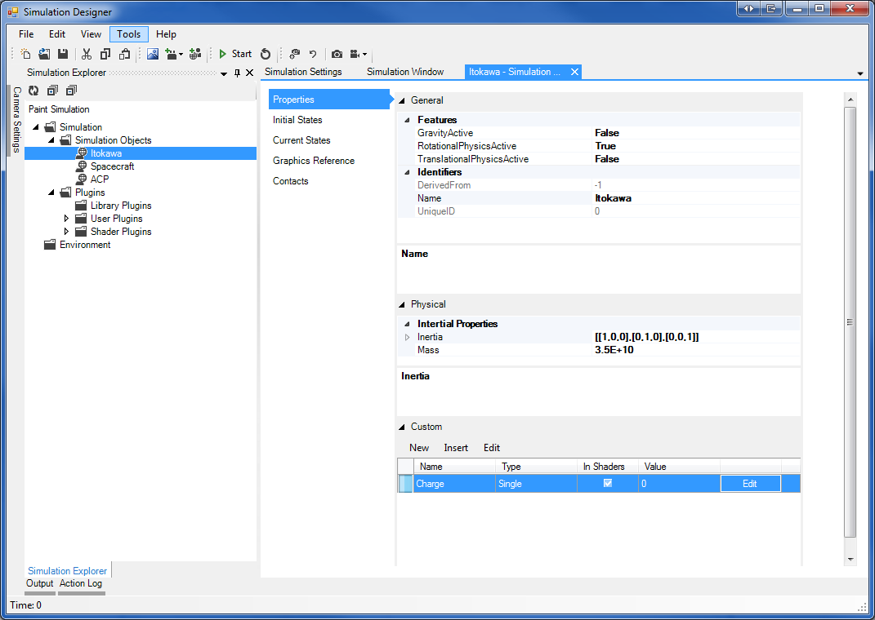
Screen Shot
SimObject Screen
Edit SimObject options, turn features on and off, define properties of object.
Assign initial physical states (position, velocity, orientation, etc)
Define the graphical representation for the SimObject.
Define the collision parameters of the SimObject.

Slide 9
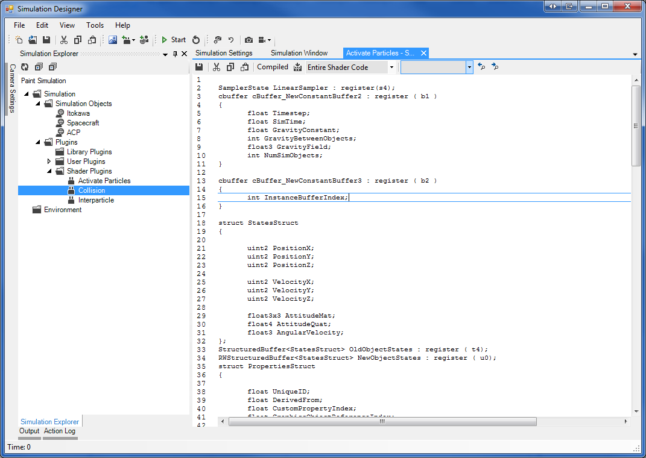
Screen Shot
Plugin Editor
Write and compile code to be executed on the GPU.
User defined code can have many effects not limited to defining forces on object, constraining states, handling run-time user input, and handling collisions.

